Slide 1



Paper Id - P20242473
Title - A Blockchain Based Framework for Secure and Decentralized Document Integrity Using Filecoin and Smart Contract
Presenter Name: Anushka Zade
Affiliation: Shri Ramdeobaba College of Engineering & Management
22nd OITS International Conference on Information Technology
(OCIT-2024)
December 12th – 14th, 2024

Slide 2
Introduction
Document management is critical across sectors like healthcare, finance, and legal.
Traditional systems face issues of centralization, inefficiency, and security risks.
Blockchain offers a decentralized and tamper-proof solution for record management.
PaperChain integrates Filecoin and smart contracts to address these challenges.
12/6/2024

Slide 3
Background
Traditional document systems rely on centralized databases prone to breaches.
Manual processes introduce errors and inefficiencies.
Blockchain provides distributed ledgers, minimizing risks of tampering.
Cryptographic tools ensure data integrity and transparency.
12/6/2024

Slide 4
Literature Survey
Blockchain emerged to ensure security, transparency, and decentralization.
Enigma introduced privacy-focused decentralized computation platforms.
IPFS in 2020 enabled secure electronic medical records storage.
IoHT frameworks improved provenance and robustness for document integrity.
Decentralized access control and tokenized trading expanded applications.
Innovations like xDBAuth and CSEdge advanced authentication and collaborative storage.
Gaps remain in integrating Filecoin and smart contracts for secure document management.
12/6/2024

Slide 5
Problem Identification
Centralized systems are vulnerable to data breaches and tampering.
Manual processes lead to delays, errors, and increased costs.
Current blockchain solutions often lack scalability and accessibility.
Need for a unified framework addressing these gaps.
12/6/2024

Slide 6
Methodology
PaperChain Framework: Integrates Filecoin, FVM, IPC, and smart contracts for decentralized document management.
Filecoin VM: Supports smart contracts with FVM, 200+ projects, 2,400 contracts, 1.65M wallets, and 2M+ terabytes stored. Tools like Boost and Lassie enhance data retrieval.
IPC (InterPlanetary Consensus): Ensures cross-chain interoperability, scalability through sharding, and strong security against attacks.
Smart Contracts: Automated, transparent agreements written in Solidity, ensuring tamper-proof execution on blockchain.
12/6/2024

Slide 7
Methodology
MetaMask: A crypto wallet enabling secure transactions and smart contract execution via decentralized applications.
Process: Documents are digitally signed, verified via hash matching, and reflected in digital wallets for seamless interactions.
Verification: Involves data preparation, deal proposal creation, event logging, and secure data access using Boost SP.
12/6/2024

Slide 8
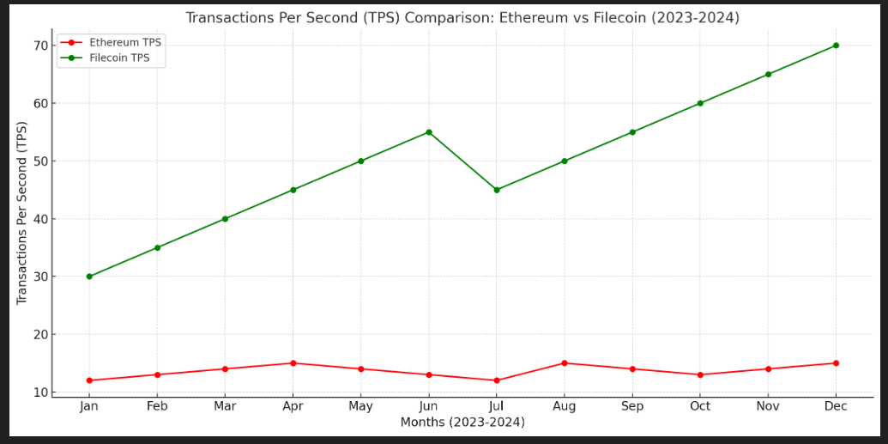
Results and Discussion
Framework Analysis: Filecoin + IPC vs Ethereum and others.
Interoperability: Seamless multi-blockchain (ours) vs limited (others).
Scalability: High with FVM vs limited, causing latency.
Data Retrieval: Fast with Boost/Lassie vs slower in others.
Security: Multi-layered consensus vs single-layer in others.
Cost Efficiency: $0.01-$0.05/GB vs $0.10-$0.15/GB.
TPS Comparison: Filecoin (30-70) > Ethereum (12-15).
12/6/2024

Slide 9
Conclusion
PaperChain: Robust framework for secure document verification.
Features: Transparency, cryptographic proofs, timestamping.
Integration: MetaMask for secured transactions.
Scalability: Infrastructure for higher transaction throughput.
Innovation: Enhanced security and platform interoperability.
Expansion: Explore blockchain use in diverse sectors.
Vision: Scalable, future-ready leader in document authentication.
12/6/2024

Slide 10
References
G. Zyskind et al., "Enigma: Decentralized Computation Platform with Guaranteed Privacy," 2015.
J. Sun et al., "Blockchain-Based Secure Storage and Access Scheme For Electronic Medical Records in IPFS," IEEE Access, 2020.
M. A. Rahman et al., "Secure and Provenance Enhanced Internet of Health Things Framework: A Blockchain Managed Federated Learning Approach," IEEE Access, 2020.
G. Ali et al., "xDBAuth: Blockchain Based Cross Domain Authentication and Authorization Framework for Internet of Things," IEEE Access, 2020.
L. Yuan et al., "CSEdge: Enabling Collaborative Edge Storage for Multi-Access Edge Computing Based on Blockchain," IEEE Transactions on Parallel and Distributed Systems, 2022.
H. Duan et al., "Towards Practical Auditing of Dynamic Data in Decentralized Storage," IEEE Transactions, 2023.
12/6/2024

Slide 11
Thank You
12/6/2024

